Slide 1

A MINI PROJECT.
OBJECT ORIENTED PROGRAMMING IN C++
Project title: Banker's Algorithm
Faculty In-charge : Shubha V Rao
Moksh Jayanth G R - 1BM19IS094
Mohan D - 1BM19IS092

Slide 2
PROBLEM STATEMENT
The Project uses 'Banker's Algorithm' to solve the deadlock problems arising in the operating systems.
What is Banker's Algorithm?
The banker’s algorithm is a resource allocation and deadlock avoidance algorithm that tests for safety by simulating the allocation for predetermined maximum possible amounts of all resources, then makes an “s-state” check to test for possible activities, before deciding whether allocation should be allowed to continue.
In simple words Banker's Algorithm is used to find whether the execution of sequence of processes will lead to a deadlock state or not.

Slide 3
1. Available: It is an array of length m. It represents the number of available resources of each type. If Available[j] = k, then there are k instances available, of resource type R(j).
NOTATIONS USED IN THE ALGORITHM
Banker's algorithm works in a similar way in computers.
Whenever a new process is created, it must specify the maximum instances of each resource type that it needs, exactly.
Let us assume that there are n processes and m resource types. Some data structures that are used to implement the banker's algorithm are:
2. Max: It is an n x m matrix which represents the maximum number of instances of each resource that a process can request. If Max[i][j] = k, then the process P(i) can request atmost k instances of resource type R(j).
3. Allocation: It is an n x m matrix which represents the number of resources of each type currently allocated to each process. If Allocation[i][j] = k, then process P(i) is currently allocated k instances of resource type R(j)
4. Need: It is an n x m matrix which indicates the remaining resource needs of each process. If Need[i][j] = k, then process P(i) may need k more instances of resource type R(j) to complete its task.
Need[i][j] = Max[i][j] - Allocation [i][j]

Slide 4
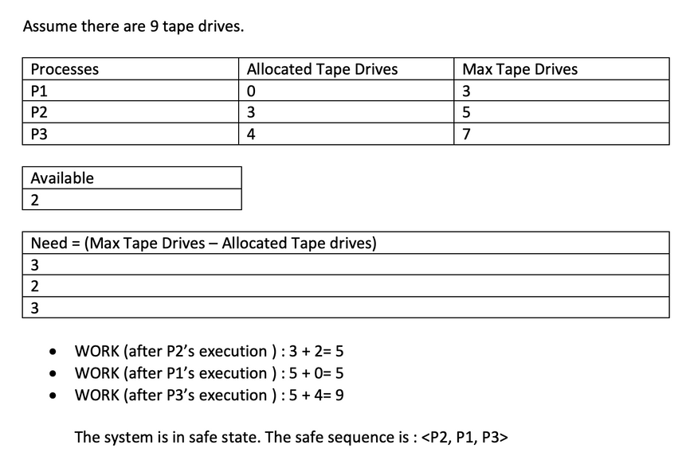
1. Safety Algorithm
Let Work and Finish be vectors of length m and n, respectively. Initially,
Work = Available
Finish[i] =false for i = 0, 1, ... , n - 1.
This means, initially, no process has finished(Mark all process unfinished.)
and the number of available resources is represented by the Available array.
2. Find an index i such that both of these conditions satisfies,
1) Finish[i] ==false
2) Needi <= Work
If there is no such i present, then proceed to step 4.
It means, we need to find an unfinished process whose need can be satisfied by the available
resources. If no such process exists, just go to step 4.
3. Now After we find a process which satisfies the above conditions, we execute that process and release all its allocated resources to 'work'.
Work = Work + Allocation;
Finish[i] = true;
Go to step 2.

Slide 5
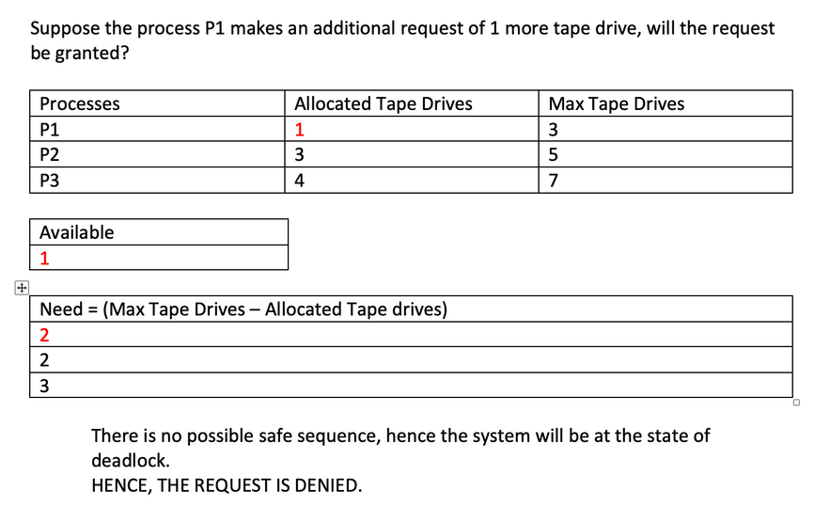
Go to step 2.
When an unfinished process is found, then the resources are allocated and the process is marked finished. And then, the loop is repeated to check the same for all other processes.
4. If Finish[i] == true for all i, then the system is in a safe state.
Or else the system is in deadlock.
2. Resource Request Algorithm
This describes the behavior of the system when a process makes an additional resource
request in the form of a request matrix. The following conditions must be met :
Condition: The number of requested instances of each resource is less than or equal
to the corresponding need .
1) If the condition does not satisfy, the request is straight away denied.
2) If the condition satisfies, do the following and apply safety algorithm again. If the safety
algorithm results in deadlock, again the request is denied.
Available = Available - Request(i)
Allocation(i) = Allocation(i) + Request(i)
Need(i) = Need(i) - Request(i)

Slide 6
OVERALL PROJECT DIAGRAM
BANKER'S ALGORITHM PROJECT
main.cpp
class.h
functions.h
BankersFile.txt
-This file contains the main() function, where the execution of the program begins.
-This file contains the definition of a single class called 'Matrix'.
-This file contains the definitions of all the functions required for the program.
-This is a text file. The entire solution to banker's problem is written into this file.

Slide 7
Softwares and Programming Concepts
Programming concepts used in the project:
Softwares used for the project:
Microsoft visual studio code - as code editor
Gcc version 10.2 - compiler
Modular programming
Classes and Objects.
Parameterized Constructors.
Dynamic allocation of member variables.
Files
ostream and istream Operator overloading using friend functions.
Binary operator(+,-) overloading using member functions.
Exceptions

Slide 8
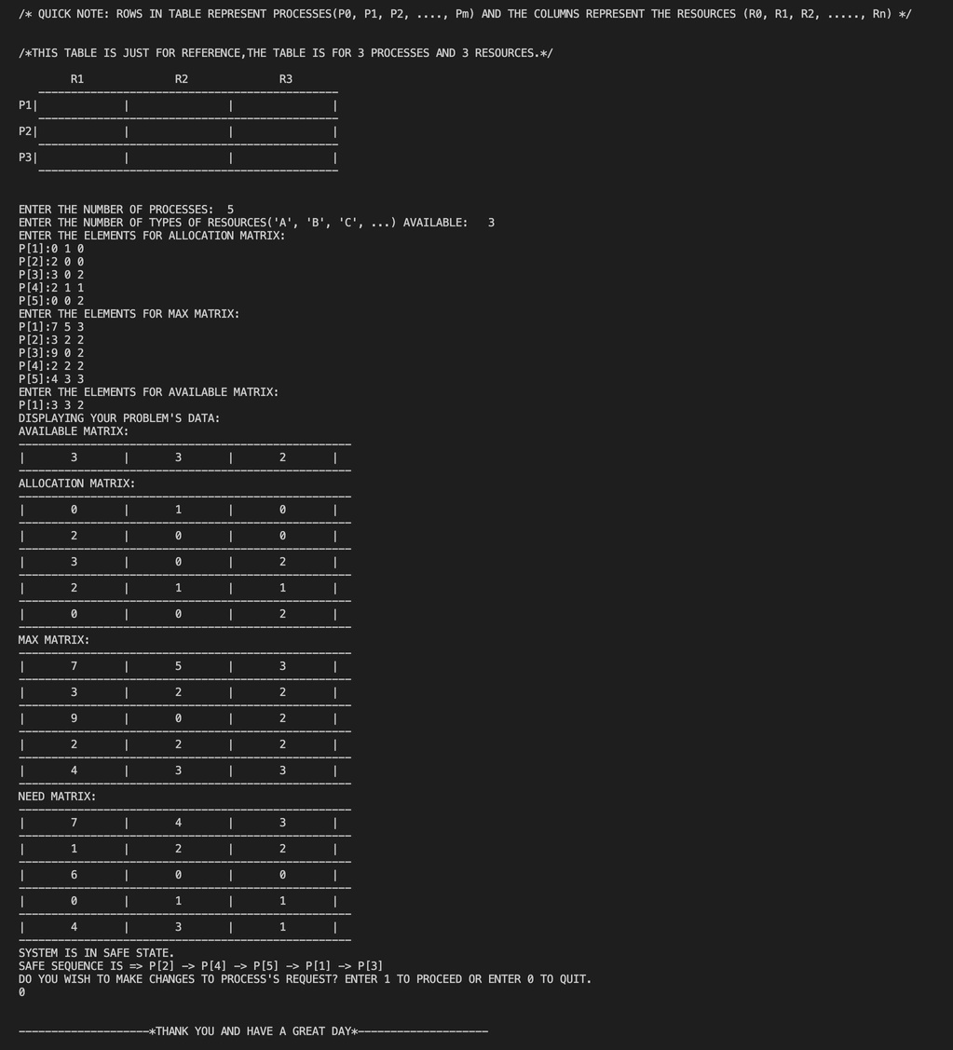
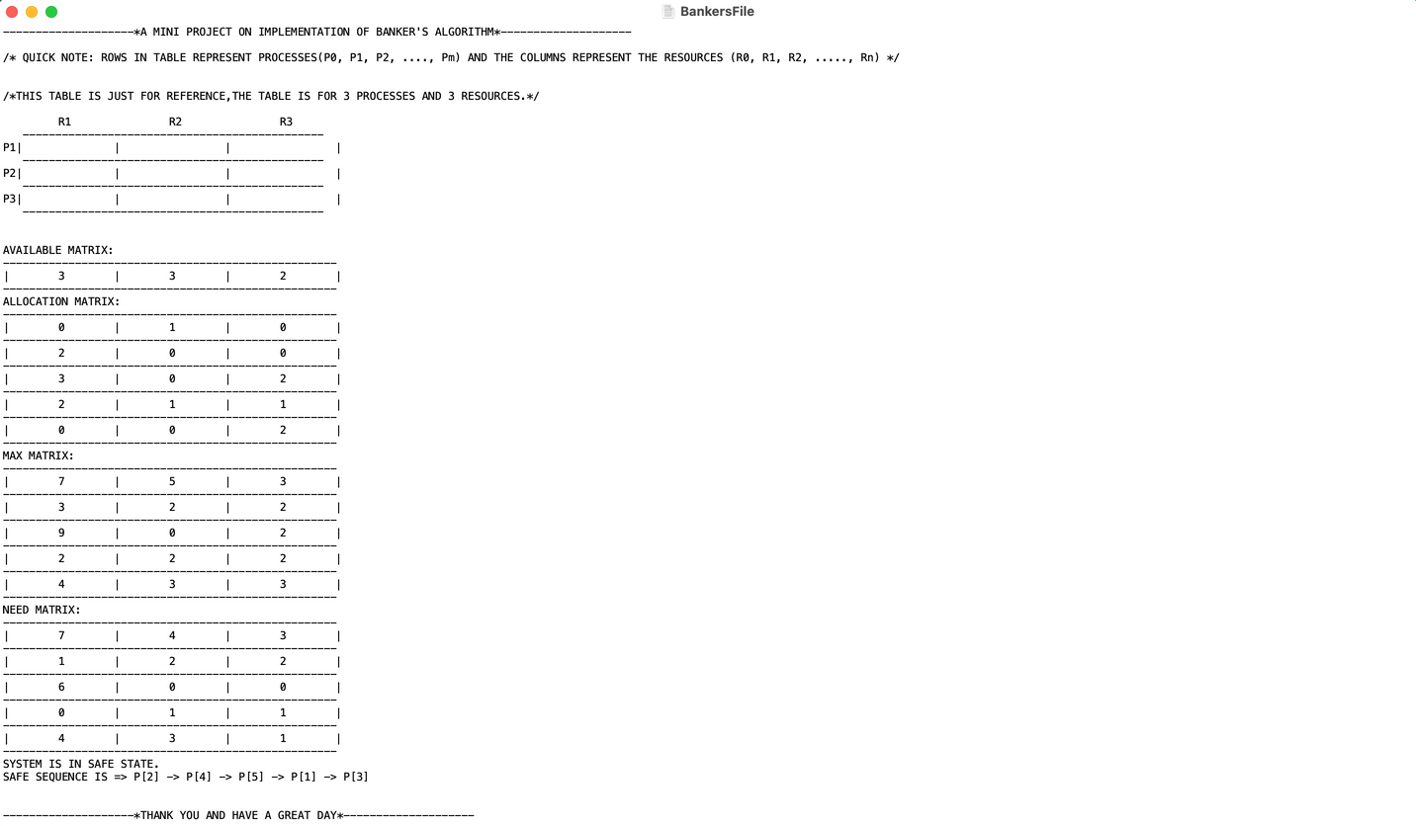
SNAPSHOTS OF THE OUTPUT
Output written into a file.
Output displayed in the console

Slide 9
THANK YOU AND HAVE A GREAT DAY.

